Slide 1
Chapter 5 Phishing and ID Theft

Slide 2
5.1 Introduction
Phishing is one of the methods towards enticing netizens to reveal their personal
Data that can used for ID theft
ID theft involves unauthorized access to personal data
Phishing has become a universal phenomenon and a major threat worldwide
That affects not only individuals but also industries and businesses that have
an Online presence and that do online transactions over internet
Phishing = Technology + Psychology

Slide 3
Statistics about Phishing
Avira.com
Virus Lab at Avira is continuously monitoring the evolution of e-mail Phishing across the globe
The World Phishing Map available at www.avira.com illustrates that the most Phishing attacks are on the rise in Asia,Europe and North America

Slide 4
Statistics about Phishing
M86security.com
Monitors continent of origin “Europe” from where Phishing e-mails are sent
Europe is also the dominant source of Phishing e-mails
Facebook,HSBC,Paypal and Bank of America are the most targeted organizations in Phishing attacks
US,India and China are the most targeted countries to launch Phishing attacks

Slide 5
Statistics about Phishing
Phishtank.com
Daily monitors Phishing attacks and displays them on the website
The statistics displayed are “phishes verified as valid” and “suspected phishes submitted”
More than 5millions e-mails are identified as “Verified and valid” phished e-mails almost everyday

Slide 6
Statistics about Phishing
Symantec
According to May2009 Monthly report compiled by Symantec Security Response AntiFraud Team
3650 non-English Phishing websites were recorded(French-Italian-Chinese)
Phishing URLs were categorized based on Top-Level domains
.com 50%
.net 9%
.org 5%

Slide 7
Statistics about Phishing
APWG(Anti Phishing Working Group)
In Phishing Activity Trends Report of Q4-2009 published by APWG,Phishing trends and statistics were mentioned as follows
Financial organizations,payment services and auction websites are most targeted industries in Phishing
Port 80 is found to be the most popular port in use followed by port 443 and port 8080 among all phishing attacks

Slide 8
APWG(Anti Phishing Working Group)
International consortium founded in 2003 by David Jevans
Brought together security products and services,law enforcement agencies,government agencies,trade association,communication companies
e.g.
Symantec,McAfee,BirDefender,Verisign,Iron/key,VISA,Mastercard, American Bankers Association
Operation
-Focussed on eliminating ID theft resulting from Phishing Attacks
-Provides a platform to discuss Phishing Issues,share best practices to eliminate these attacks

Slide 9
5.1 Phishing

Slide 10
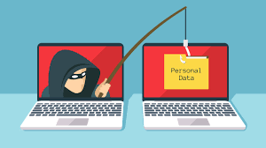

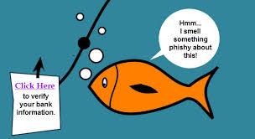
Real Time Phishing Analogy
Internet scammers are using EMAIL LURES to FISH for passwords and financial data from the sea of Internet users
Term was coined in 1996 by hackers

Slide 11
Phishing Definitions
Wikipedia Definition
It is the criminally fraudulent process of attempting to acquire sensitive information such as usernames,passwords and credit card details by masquerading as a trustworthy entity in electronic communication
Webopedia Definition
It is an act of sending an e-mail to user falsely claiming to be an established legitimate enterprise in an attempt to scam the user into surrendering private information that will be used for ID theft
TechEncyclopedia Definition
It is a scam to steal valuable information such as credit card and social security numbers,user IDs and passwords
Also known as BRAND SPOOFING

Slide 12
In Summary
Phishing is a type of deception designed to steal your identity
The Phisher tries to get the user to disclose the valuable data such as credit card numbers,passwords,account data,etc.
E-mail is the popular medium used in the Phishing attacks
Phishing e-mails are called as Spams
Can be categorized as Spam e-mails and Hoax e-mails

Slide 13
Spam E-mails
Also known as Junk e-mails
Involve identical messages set to numerous recipients
Grown since 1990
Botnets are used to send about 80% of Spam
Types of spam e-mails
1.Unsolicited bulk e-mail(UBE)
Unsolicited e-mail sent in large quantity
2.Unsolicited commercial e-mail(UCE)
Unsolicited e-mails are sent in large quantities from commercial perspective
e.g. Advertising

Slide 14
Spam e-mails proved to be a popular medium for phishers to scam users to
enter personal information on fake websites using e-mail forged to look like
as if it is from a bank or other organizations such as :
1.HSBC,Sanrtander,Common Wealth Bank :
International banks always have large customer base so phishers always dive in
such ocean to hook the fishes
2.eBay
It is a popular auction site often mimicked to gain personal information
3.Amazon
Was top brand to be exploited by Phishers till July 2009
4.Facebook
Putting personal information on social websites increase the chances of being
fished

Slide 15
Details of Spam e-mails
The e-mail will usually ask the user to provide valuable information about
himself
Or
The e-mail may tell to verify information that the user may have provided in the
past while registering for online account

Slide 16
Tactics used by Phishers
To maximize the chances that a recipient will respond,the phisher might employ
any or all of the following tactics
1.Names of legitimate organizations
Instead of creating a company from scratch,the phisher might use a leigitimate
company’s name and incorporate the look and feel of its website into spam e-
mail

Slide 17

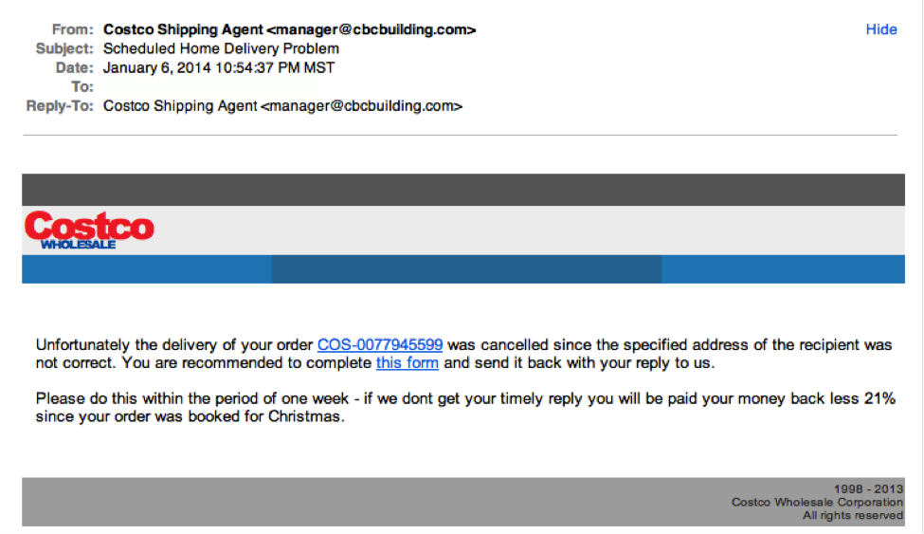
Example

Slide 18
Tactics used by Phishers
2.From a real employee
Real name of an official who actually works for the organization will appear in
the “from” line and/or text of the mail
This way i user contacts the organization to confirm whether “Mr.X” is “Vice
President of Marketing”,the user gets positive response and trusts the
authenticity of the e-mail
3.URLs that look right
E-mail might contain a URL which seems to be legitimate website wherein user
can enter the information the phisher would like to steal
But,actually website will be a spoofed website that looks like the real one

Slide 19
Tactics used by Phishers
4.Urgency messages
-Creating a fear to trigger a response is very common in Phishing attacks
-The e-mails warn that failure to respond will result in no longer having access
to the account or e-mails
-Might claim that organization has detected suspicious activity in user’s
account Or organization is implementing new privacy software for ID theft
solution

Slide 20
Phrases used by Phishers
1.Verify your account
-The legitimate organization will never ask the users to send user Ids,passwords,
PANs and other PII through e-mail
e.g.
e-mail which appears to be from Microsoft to update you credit card information
2.If you don’t respond within TWO hours,your account will be closed
The messages convey a sense of urgency so that you will respond immediately without thinking

Slide 21
Phrases used by Phishers
3.You have won the lottery
-Lottery scam is a common phishing known as advance fee fraud
-A message that claims that you have won a large sum of money
-Often claimed to be from famous companies like Microsoft
-Most phishing e-mails display the name of the agencies in Great Britain
-If you get any e-mail saying “You have won a lottery in Great Britain”,confirm
first it on www.gamblingcommission.gov.uk
-If you get any e-mail saying “You have gor a job in Great Britain”,verify it on www.companieshouse.gov.uk

Slide 22
How to reduce no.of Spam e-mails received
Share personal e-mail addresses with limited people and/or website
Never reply or open Spam e-mails otherwise phisher will know that your e-mail
ID exists
Spell out your e-mail address as “nehaATgmailDOTcom” on social website
This will prohibit phishers to catch valid e-mail addresses while gathering e-mail addresses through programs
Use alternate e-mail addresses to register for any personal or shopping website
Don’t forward any mails from unknown recipients
Make a habit to preview e-mails before opening
Never use e-mail address as screen name in chat groups
Never respond to spam e-mail asking to remove your e-mail address from their mailing lists as it confirms to the fishers that your e-mail address is active

Slide 23
Hoax e-mails
Websites below can help to check the validity of hoax e-mails
www.breakthechain.org
This website contains a huge database of chain e-mails
Fisher sends these chain e-mails to force netizens to reply
e.g.Lottery schemes,Your wish will come true
www.hoaxbusters.org
Contains a database of hoaxes maintained by Computer Incident Advisory Committee
Contains information about almost every scam,frivoulous warning,news
e.g.
Mail title : Braking news
Content : Barack Obama refused to be the president of US
From CNN

Slide 24
Hoax e-mails
Attempt to deceive or trick user into believing or accepting that something is real when the hoaxer knows it is false
Hoax e-mails may or may not be spam
It is difficult to recognize whether an e-mail is hoax or spam
Websites below can help to check the validity of hoax e-mails

Slide 25
5.2.1.Methods of Phishing
1.Dragnet
2.Rod and reel
3.Lobsterpot
4.Gillnet

Slide 26
5.2.2.Phishing Techniques : Techniques used to launch Phishing attack
1.URL(Weblink manipulation)
URL-Universal Resource Locator
URLs direct the users to a particular website
Phishers use Lobsterpot Phishing and make the difference between one or two letters in URLs which is ignored by users
After clicking the URL user is directed to fake website which looks like legitimate website

Slide 27
5.2.2.Phishing Techniques : Techniques used to launch Phishing attack
2.Filter Evasion
-Uses graphics instead of text to obviate from netting phishing e-mails by
phishing filters
-Usually phishing filters are inbuilt into web browsers
-IE7 has Microsoft Phishing filter which can be enabled during or after
installation
-Firefox 2.0 and above have Google Phishing filter

Slide 28
5.2.2.Phishing Techniques : Techniques used to launch Phishing attack
3.Website Forgery
Fisher directs the netizens to the website designed and developed by him
The user is directed to login page after clicking on the website link
As user gives the login details,phisher gets the confidential information very easily

Slide 29
5.2.2.Phishing Techniques : Techniques used to launch Phishing attack
4.Social phishing
Phisher entice the netizens to reveal sensitive information in a systematic manner by social means
Phisher sends e-mail as if it is sent by a bank asking to call them back because there was security breach
The victim calls the bank on the number provided in mail
The phone number provided in mail redirects victim to phisher
Phisher speaks with the victim similar to a bank employee asking to verify the victim that he is a bank customer by giving credit card credentials
Phisher gets the required data

Slide 30
5.2.2.Phishing Techniques : Techniques used to launch Phishing attack
5.Phone phishing(Vishing)
Phisher uses a fake caller ID data to make it appear that the call is from legitimate organization to entice the users to reveal their personal information

Slide 31
5.2.3.Spear Phishing
Definition
It is a method of sending a Phishing message to a particular organization to gain organizational information for more targeted social engineering
How it works
1.Phishers sends e-mail that appears genuine to all the employees within a certain company,government agency or group
2.The message looks like coming from employer or colleague who usually sends e-mails to everyone in company
3.Contents : request for usernames or passwords
4.Motive : gain access of company’s entire computer network

Slide 32
5.2.3.Spear Phishing
Whaling
Spear phishing targeting executives from top level management in the organizations
Objective
To force executives into revealing confidential information
What it does : installs malware for keylogging or backdoor
E-mails are designed as critical business e-mail sent from legitimate body or authority
Content : false industry concern

Slide 33
5.2.3.Spear Phishing
Whaling
e.g.
Whaling fishes have forged FBI subpoena e-mails and claimed that manager needs to click a link and install a special software to view subpoena
In 2008 FBI subponea whaling scam,20000 CEOs were attacked,2000 of them fell for it and clicked on the whaling link to download software needed to view FBI subpoena document
Actually the link was a keylogger,provided CEO’s password to phishers
as a result,2000 companies’ data was compromised

Slide 34
5.2.4.Types of Phishing Scams
1.Deceptive Phishing
Phishing scams started by broadcasting deceptive e-mails with the intention of ID theft
Broadcasted to a wide group of users
To verify bank account information
System failure : re-enter the personal information
Fictitious account charges
Undesirable account changes
Free services

Slide 35
5.2.4.Types of Phishing Scams
2.Malware based phishing
Scams that involve running malicious codes on user’s system
Malware can be launched as an e-mail attachment,or downloadable file from a website
3.Keyloggers
Malware can embed a keylogger to track keyboard input and sending the
confidential data to phisher
Keyloggers can be embedded in netizen’s browser as a small utility which
start automatically when the browser is opened

Slide 36
5.2.4.Types of Phishing Scams
4.Session hijacking
It is an attack in which user’s activities are monitored until they login the
credentials and begin the transaction and at that point the malicious code
takes over and unauthorized actions like fund transfer are done
5.In session phishing
Based on one web browsing session being able to detect the presence of another session on same browser
E.g.visit to online banking website,suddenly a pop-up window opens and it appears to be opened from targeted session

Slide 37
5.2.4.Types of Phishing Scams
6.Web trojans
It pops-up to collect user’s credentials and transmits them to fisher
7.System configuration attacks
Phisher intrudes into user’s system to modify the settings for malicious purposes
E.g.
URLs saved under Favourites in the browser might be modified to redirect user to look-alike fake website

Slide 38
5.2.4.Types of Phishing Scams
8.Data theft
Critical and confidential data gets stolen
Most corporate data resides on the corporate servers and the web and e-theft is easy and less chance of being caught
Used for business espionage
Used for blackmailing and earning money
9.Content injection phishing
Phisher replaces part of the content of legitimate website with false content to mislead the users to reveal the confidential information

Slide 39
5.2.4.Types of Phishing Scams
10.Man in the middle phishing
Phisher positions himself between user/netizen and legitimate website
Phisher records the data being provided by victim,passes it to legitimate website so that victim may not get suspicious and later on will use this data
11.Search engine phishing
Phishers create websites with attractive offers and have them indexed legitimately with search engines
Netizens find these offers during surfing and are trapped to reveal personal information
E.g.less loan interests,free offers,discounts

Slide 40
5.2.4.Types of Phishing Scams
13.SSL(Secure Sockets Layer) certificate phishing
Advanced type of scam
Phishers target web servers with SSL certificates to create a duplicate website with fraudulent webpages
Display “lock” icon
SSL certificates are always found to be legitimate as they match URL of fake pages

Slide 41
5.2.4.Types of Phishing Scams
14.Pharming
Host file pharming
Previously Windows used to have host names in host file
Phishers used to poison the host file to redirect to a fake website which looks alike the original website
DNS(Domain Name System) based pharming/DNS hijacking
Phisher tampers DNS so that request for any URL returns fake address and users are directed to a fake website

Slide 42
5.2.5.Phishing Toolkits and Spy Phishing
Phishing toolkit is a set of programs that allows a phisher to automatically set up phishing websites that spoof the legitimate websites of different brands including images and logos displayed on their websites
Developed by groups or individuals and are sold underground
Difficult to obtain,are quite expensive and are purchased by well organized phishers
Phishers use PHP(Hypertext Preprocessor) language which is server scripting language that is used for web development
PHP can be embedded into HTML

Slide 43
5.2.5.Phishing Toolkits and Spy Phishing
Examples of Phishing toolkits
1.Rock fish
-Popular since 2005
-Allows non technical people to launch phishing attack
2.Xrenoder Trojan Spyware
Resets homepage or search settings to point to other websites usually for
commercial purposes

Slide 44
5.2.6.Phishing Countermeasures
1.Keep antivirus up to date
2.Do not click on hyperlinks in e-mail
3.Install antispam software : To keep phishing arracks at minimum
4.Verify https(SSL) : Ensure address bar displays https:// not just http:// and a secure lock icon(*Check the security info by double clicking lock icon”
5.Use anti spyware software : to keep spyware to minimum
6.Get educated
7.Use firewall : to prevent malicious code from entering the system
8.Take backup
9.Don’t enter sensitive information into pop-up windows
10.Install anti phishing plug-ins

Slide 45
5.2.6.Phishing Countermeasures
Anti phishing plug-ins
1.ScamBlocker,PhishNet1.2 : protect users from phishing scams
2.SpoofStick : It helps users detect spoofed websites
3.Google safe browsing : Alerts when a webpage asks for user’s PII or
financial information
4.Windows Internet Explorer’s phishing filter :
-Available on IE7
-Helps to potect users from entering Phishing sites

Slide 46
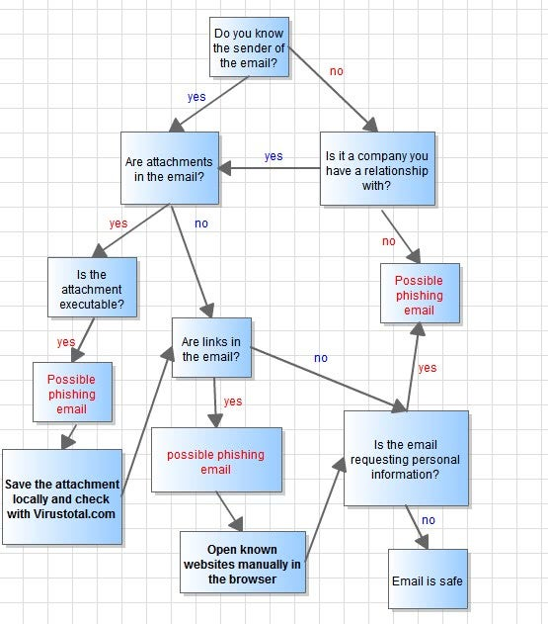
Flowchart

